Slide 1
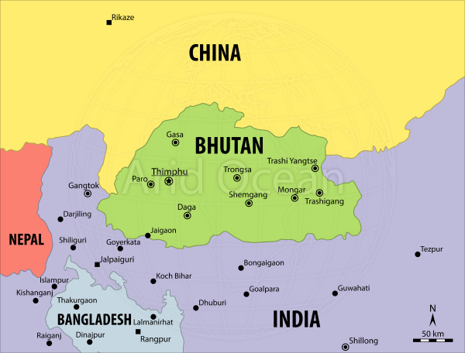
Leadership & Economic Development in Bhutan
Prem Dhungyel
MP1 Student
GRIPS

Slide 2
Outline
Country Profile
General Concepts of Leadership
Leaders in Bhutan
Bhutan’s path to development
Significant Achievements
Challenges
Policy measures & conclusion

Slide 3
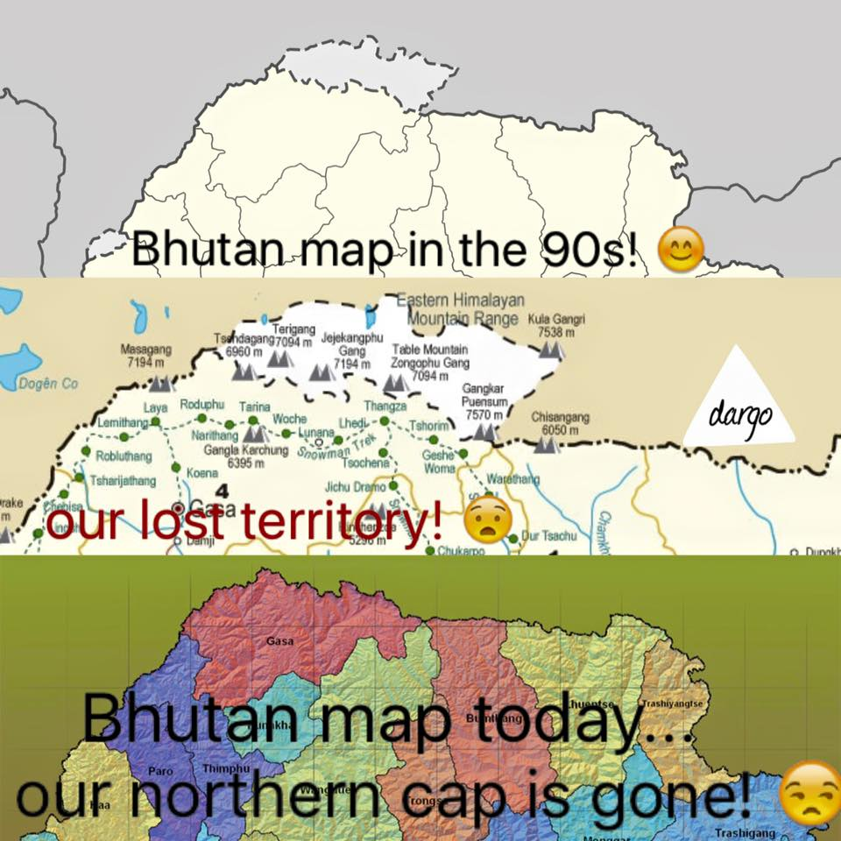
Country Profile
Location: N = China,
S = India
Total Pop: 0.746m
Land Area:
38,394 sq.km

Slide 4
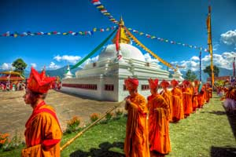
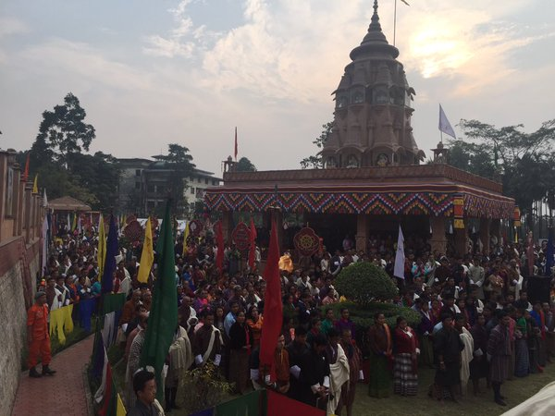
Contd…
Religion: Buddhism & Hinduism
Government: Democracy
PCI: $2837
Life Expectancy:
Female: 70.51
Male: 69.51

Slide 5
General Concepts of Leadership
Great leaders possess dazzling social intelligence, a zest for change, and above all, vision that allows them to set their sights on things that truly merit attention
A leader must possess compassion
Well educated and skilled tends to be better at doing things differently

Slide 6
Leaders since 1907

Slide 7
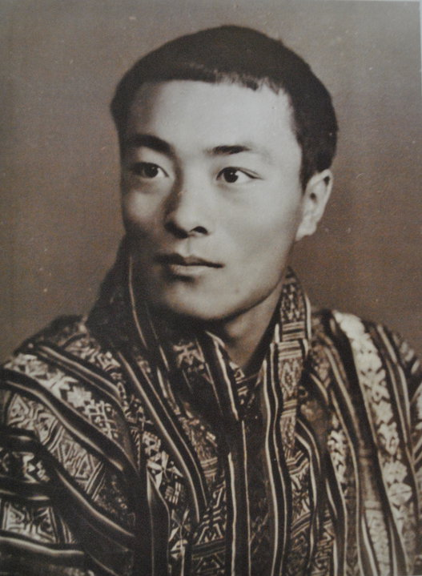
Leaders in Bhutan
Father of Modern Bhutan
Five Year Planning started in 1961
Joining international community
Jigme Dorji Wangchuck
Infrastructure development
Industrial policy for belter life
Third King (1952-1972)

Slide 8
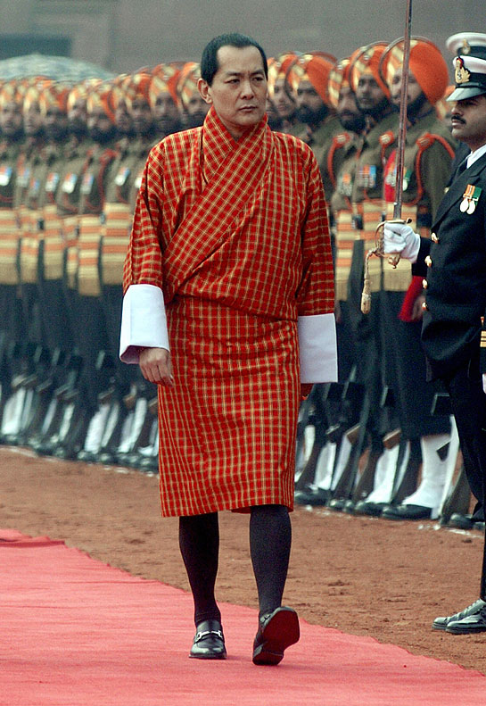
Contd…….
Introduced GNH as a development paradigm
Pouring of democracy in Bhutan
Economic growth accelerated
Jigme Singye Wangchuck
Step to Middle income country
Dramatic increase in GDP per-capita
Focus on hydropower development
Fourth King (1972-2006)
Industrial development

Slide 9
Bhutan’s path to development since 1972(4k)
Sustainable and Equitable Socio-economic Development
Good Governance
Environment Conservation
Pillars
Promotion & Preservation of Culture

Slide 10
Psychological Wellbeing
Living Standard
Time Use
Education
Ecology
9 Domains
Cultural Diversity
Community Vitality
Good Governance
Health

Slide 11
Policy Formulation Process in Bhutan(4k)
Review sectorial policies for govt. approval
LDC
DDC
GNHC
Cabinet
Approval
Coordinate policy formulation
Formulation of five year plans with government

Slide 12
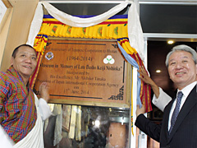
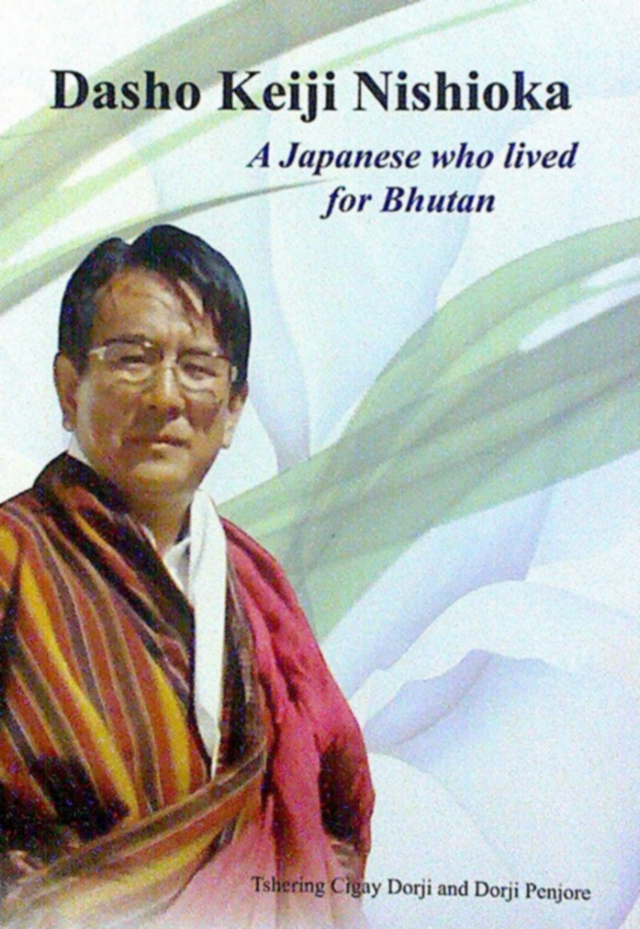
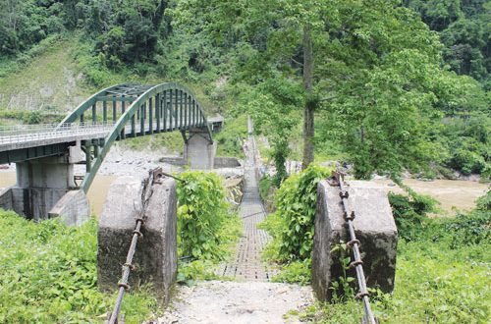
Significant Achievements (4k)
Nishioka bridge
Agriculture development attributed to Dasho Nishioka
A museum to commemorate the man who modernized agriculture in Bhutan, the late Dasho Keiji Nishioka
Regarded as father of agriculture revolution in Bhutan
Born in Japan but lived for Bhutan (As cited in Bhutanese history)

Slide 13
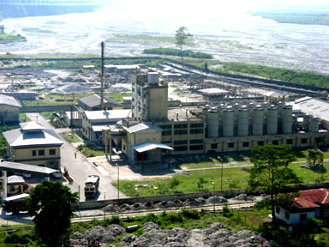
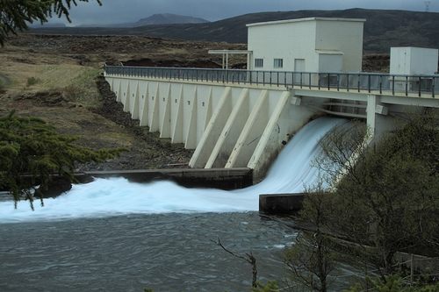
Contd……
Major Industries established in Bhutan(4k)
Pasakha Industrial Zone
Gomtu Cement Factory
Tala Hydroelectric Project

Slide 14
Hydropower in Bhutan(4k)
Generating Projects
Chukha Hydropower Plant | 336 Megawatt
Basochhu Hydropower Plant | 64 Megawatt
Kurichhu Hydropower Plant | 60 Megawatt
Tala Hydropower Plant | 1020 Megawatt
Dagachhu Hydropower Plant | 126 Megawatt

Slide 15
On-going Projects
Kholongchhu Hydropower Plant | 600 Megawatt
Bunakha Hydropower Plant | 180 Megawatt
Wangchhu Hydropower Plant | 570 Megawatt
Chamkharchhu Hydropower Plant | 770 Megawatt
Punatshangchhu-I Hydropower Plant | 1000 Megawatt
Punatshangchhu-II Hydropower Plant | 990 Megawatt
Amochhu Hydropower Plant | 500 Megawatt
Digala Hydropower Plant | 670 Megawatt
Shingkhar Hydropower Plant | 570 Megawatt
Mangdechhu Hydropower Plant | 670 Megawatt
Nikachhu Hydropower Plant | 210 Megawatt
Kurichhu Hydropower Plant | 401 Megawatt

Slide 16
GDP from 1985-2015(4k)
Year | GDP in USD
1985 | 175
1990 | 279
1995 | 294
2000 | 460
2005 | 828
2008 | 1280
2015 | 2 billion

Slide 17
GDP Per Capita since 1980s(4k)

Slide 18
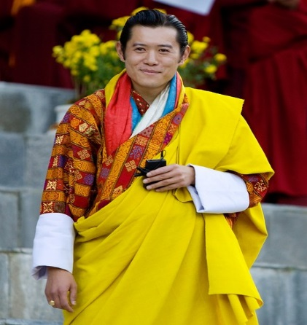
Roles of King after 2008(4k)
Citizenship and land
Command bills passed in parliament
Appointment of important executives
Establish international relations & honor state guests
Control over armed force personnel
Direct influence on addressing issues

Slide 19
Challenges
GNH, a fine concept but how to quantify
Threat of globalization and media
Poor human capital
Shortage of manpower
Sustainability of hydropower
Still major authority lies with king

Slide 20
Policy measures & conclusion
Focus on tourism sector
Attract FDI and drive win-win situation
Empower universities and academic institutions
Set up export-oriented industries through FDI
Brand Bhutan

