Slide 1
Minimum Conditions and Performance Measures (MCPM)
A Tool of Performance Monitoring in Local Governments of Nepal
(Policy Design and Implementation in Developing countries)
Resham Lal Kandel
Student ID: MEP15112
Country: Nepal
Affiliation: Ministry of Federal Affairs and Local Development

Slide 2
Outline
Overview of governance system in Nepal
Overview of the Performance of LBs
–Existing situation, and issues on the Performance of LBs
Learning & Development
–MCPM, its initiation and mainstreaming.
Future prospective

Slide 3
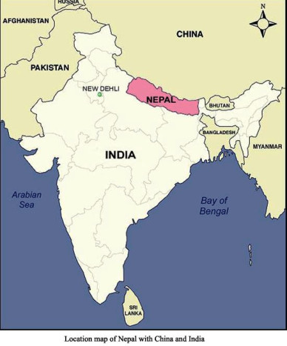
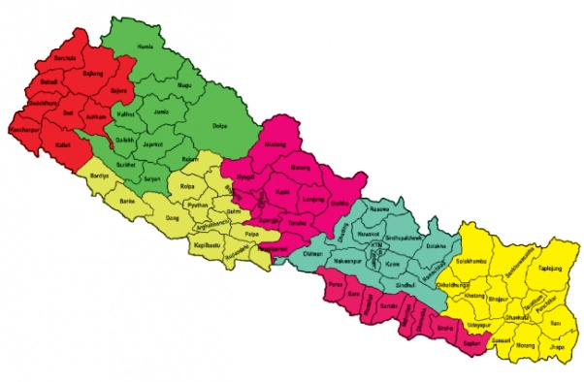
Political divisions
7 Provinces,
75 Districts,
206 Municipalities & 3276 VDCs

Slide 4
Overview of Governance System in Nepal
President
Policy Making
In Transitional Phase of Unitary and Federal Government
Parliament
Executive Body
Judiciary
Other constitutional Bodies
Council of Ministers
NPC
Ministries
DDCs
Implementation
Departments
Regional Offices
District Offices
VDCs
Municipalities
Service Centers
NPC- National Planning Commission
DDCs- District Development Committees
VDCs-Village Development Committees

Slide 5
Efforts towards Decentralization in Nepal
Commitment in Decentralization and about 50 years experience.
Fundamental principles of local governance system
–Local self-governance, and
–Principle of devolution
Local Self-Governance Act (LSGA), 1999 and its Regulation 2000.

Slide 6
Overview of the Performance of Local Bodies (LBs)
Existing Situation of local governance
LBs are autonomous on functional and financial decision making and implement their priorities.
There is growing trend of responsibilities as well as source of funding.
The new local self-governance act was enacted and elected LBs were working.
But many LBs were not accountable according to the spirit of decentralization.

Slide 7
Overview of the Performance of LBs…
The central political will power remained weak. Some local leaders were comparatively motivated, but there was no uniform working environment.
Planning and Implementation used to be delayed.
Alignment of local investment was difficult.
No more local elections were held after 2002.
Control from center was almost impossible because of the issue of autonomy.

Slide 8
Issues on the Performance of LBs
Improvements on local public services and establishing an accountable LBs.
Introduce Performance Based Grant System.
Start strong and effective tools of monitoring in the LBs.

Slide 9
Selected policy issues
How the LBs could be monitored with consideration of the principle of local autonomy and make them accountable for their responsibilities.
Introduce Minimum Conditions and performance Measures (MCPM) to monitor the performance of Local Governments.

Slide 10
What is MCPM ?
A monitoring/evaluation tool to assess the performance of LBs.
Indicator based assessment related to the duties and responsibilities of LBs based on legal provision.
Two sets of indicators:
Minimum Conditions (MC)- Threshold criteria for the LBs.
LB has to comply with the MCs if it is to be eligible to receive additional grants from the central government.
Indicators for MCs are statutory requirements of LBs as provisioned in the LSGA 1999 and associated acts, rules, regulations and directives.
Indicators for MCs are core functional areas of LBs such as planning and budgeting, financial management, functioning of various committees, transparency etc.

Slide 11
(1) MC indicators
S.N. | DDC indicators | VDC indicators | Municipality indicators
1 | Annual Budget and program approval | Annual Budget and program approval | Annual Budget and program approval
2 | Annual progress appraisal | Annual progress appraisal | Annual progress appraisal
3 | Annual and quarterly progress report | Grant utilization and accounting | Annual and quarterly progress report
4 | Internal audit and VDCs final audit | Final audit | Account operation of Municipality Fund
5 | Account operation of District Development Fund | Inventory management | Tax and record of internal revenue source
6 | Information and record management | Social security program | Audit and irregularity rectification
7 | Final audit and record of irregularities | Personnel management | Assets management
8 | Inventory management |  | Building construction and design approval
9 | Personnel management |  | Publication of revenue and expenditure details and tax rate
10 |  |  | Personnel management

Slide 12
(2) Performance Measures (PM)
      PMs provide a range of score in different functional areas that help to assess the service delivery capacity and efficiency. LBs annual grant will depend on the scores achieved in PMs.
      These indicators direct the LBs to monitor its own function, to improve internal working capacity and to compare its activities with other LBs.
      A kind of third party monitoring and bench marking.

Slide 13
(2) Performance indicators
 | Thematic areas | Remarks
DDC | Planning and Budget Management Resource mobilization and financial management Budget release and program implementation Monitoring, Assessment Communication and Transparency Organization management and work responsibility | Thematic areas-5 Total number of indicators-46
Municipality | Local governance Financial resource mobilization and management Plan and program management Organization and HRD Urban basic resource management | Thematic areas-5 Total number of indicators-40
VDC | Formulation of participatory village development program, Target group program Release and expenditure status Publication of income and expenditure statement Implementation of social security program Personal record database, VDC profile Citizen charter, Public audit, public hearing Internal resource management | Thematic areas-13 Total number of indicators-100

Slide 14
How MCPM works ?
It affects the relations-
Between Center and Local government.
Local politicians and People.
Local government units and their Clients.
Source: LGCDP, 2010. P.19

Slide 15
Assessment Method
Assessment will be done on the set indicators
For MC, only 2 option– Yes or No
For PM, There is total 100 marks.
Free License Experts (Evaluators)
Reporting to LBFC, MoFALD and MoF
Appeal to LBFC
The result is used to allocate the grants

Slide 16
Criteria for Additional Grants
S.N. | Performance rating and conditions | Reward/ sanction | Staff incentives
1 | 3 topmost DDCs/Municipalities 1 top VDC in each district | 20% addition in grant | First DDC/ Municipality – NPR 300 thousand Second DDC/ Municipality-NPR 250 thousand Third DDC/Municipality- 200 thousand
2 | Top 25% DDCs/ Municipalities/VDCs (First category) | 15% addition in grant | NPR 125 thousand for DDCs & Municipalities
3 | Second top 25% DDCs/Municipalities/VDCs (Second category) | 10% addition in grant | NPR 100 thousand DDCs & Municipalities
4 | Third 25% DDCs /Municipalities/VDCs ( Third category) | 10% deduction in grant
5 | Last 25% DDCs/Municipalities/VDCs (Lowest category) | 15% deduction in grant
6 | MC met but failed in PM (DDCs/Municipalities/VDCs) | 20% deduction in grant
7 | MC not met (DDCs/Municipalities/VDCs) | Lose all formula based grant | Note- In case of VDCs, DDC makes decisions

Slide 17
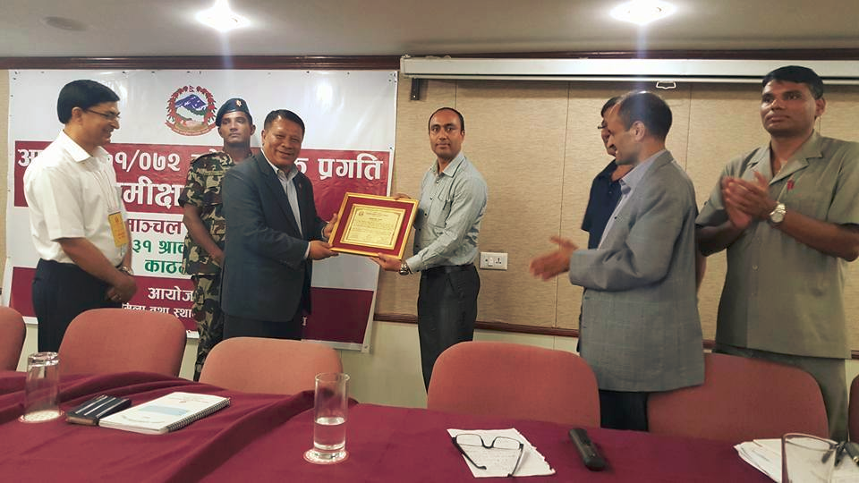
Why this System is Sustaining?
The results of MCPM
are linked with
grant of LBs.
Provision of
prize/rewards.
Resham Kandel,LDO, Dolakha - Awarded as second best performing DDC

Slide 18
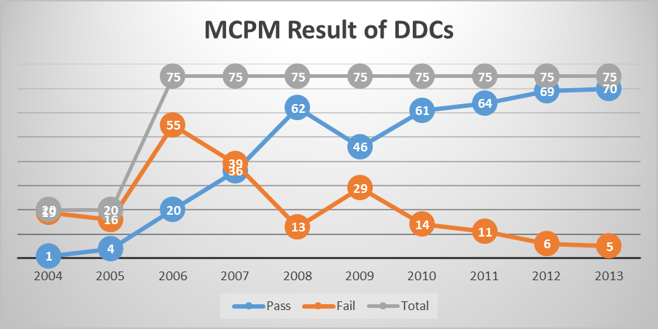
Effect of this system: How the performance status changed
DDCs-District Development Committees

Slide 19
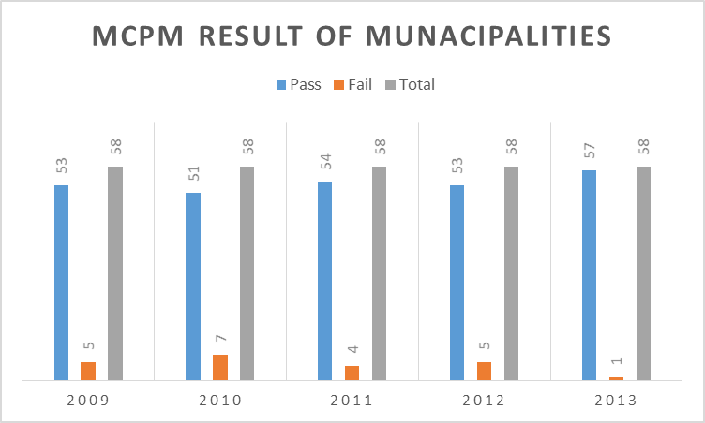
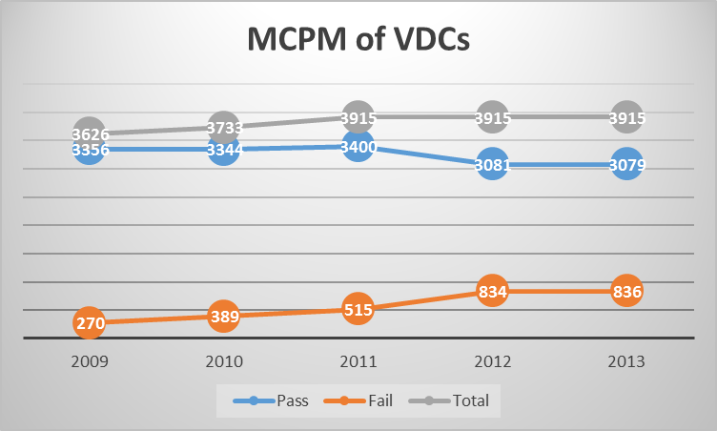
Effect of this system: How the performance …

Slide 20
How was this system initiated?
Learning from abroad !!!
Supported by (UNCDF)
  Uganda-Piloting 1997, full fledge 2003, Kenya & Mali-2001,
  Tanzania-2004, Bangladesh- piloting 2003, full fledge 2007,
  Indonesia,& Pakistan- 2005, Ghana-2008
The concept has been transferred from developed countries
Lessons from Uganda (MCPM) and Philippines (LGPMS) were in center.
Who was the Leader?
Team effort - Bureaucratic Team within LBs, Forum of local leaders
Relation with Stakeholders & Commitment in Implementation
Support from Development Partners

Slide 21
How the system mainstreamed?
The first stage
Piloting in 20 districts in 2004 - DFDP districts
The result was used to allocate unconditional (block) grant and some project specific grants (e.g. LGCDP funding)
Second Stage
Remaining 55 districts in 2006
To assure the trust (validity and reliability) of assessment process and result, quality assurance mechanism was developed.
Replication of learning.
Continuation of Implementation and DP’s trust.

Slide 22
How the system addressed in Government Policy ?
After seeing positive outcomes (in improving service delivery, planning and monitoring culture, spending capacity, record keeping and so on), Government formally accepted this system from FY 2006/07 and aligned in National System.
Case (how does this system affect?):
“Kathmandu Metropolitan City failed in FY 2008/09 in MC/PM. This triggered the local politicians who questioned the staff why it happened. Then, the things started improving.

Slide 23
Components for sustaining the system
This system is legalized by LSGA, 1999 and its regulation 2000.
It is accepted as a part of regular government function and resource allocation
Support from DPs.
Local Bodies Fiscal Commission-LBFC (independent body) is assigned to execute the assessment process
Linkage with financial incentives and penalties
Ownership:
Lead by central govt. agency
Fully accepted by LGs

Slide 24
Issue for further improvement
Improvement of Indicators (process based indicators to outcome based indicators),
Linking the results to other governance indicators.

Slide 25
Conclusion
Team effort and co-ordination between stakeholders is one important aspect of its success
Commitment in implementation from government is another factor. (Government has taken lead role)
Keys of success
Simplicity of assessment manual,
Quality assurance,
Assessment by third party (Team composition: local governance expert and financial management expert), and
Transparent indicators & process, and appeal system.

Slide 26
ANY QUESTIONS OR COMMENTS…

Slide 27
References:
Local Bodies Fiscal Commission (LBFC). (2015). An Analysis Reports of MCPM in Local Bodies of Nepal: Kathmandu. www.lbfc.gov.np
Local Governance and Community Development Programme (LGCDP). (2010). Analysis of the minimum conditions and performance measurement (MC/PM system) in Nepal.
Local Self Governance Act (LSGA). (1999).
Local Self Governance Regulation (LSGR). (2000).
United Nations Capital Development Fund (UNCDF). (2010). Performance-based grant systems: Concept and international experience.

