Slide 1
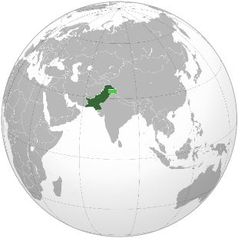
Development Planning from centralization to decentralization:
A case study of Pakistan
Imran Ali Sultan (Pakistan)
MEY 15029
YLP – School of Local Governance

Slide 2

Outline
Pakistan – an overview
Centralized Development Planning
  Key Features
  Results
  Analysis
Decentralized Development Planning
  18th Constitutional Amendment – Empowering Provinces
  7th National Finance Commission Award
  Local Governments Devolution Plan 2000
Conclusion
Notes:
“Information and Communication Technologies”
Transforming government and governance
Economic development and poverty alleviation
Sector applications
KIT and development
“Knowledge, Innovation, and Technology Systems”
Infrastructure
Processes
Sector Applications
“Current Landscape of KITS in Developing Countries”
Inequalities of scientific output and technologies innovation exceed global income inequalities
Government and public sector will be instrumental
“National KITS: Role of the Public Sector”
Strategic framework and policy
Value-added activities

Slide 3
Centralized planning (1958-1969)
National Economic Council
Planning Commission
Ministry of Finance
Five Years Plans
  Second Five Year Plan (1960 – 1965)
  Third Five Year Plan (1965 – 1970)
Focused Areas
  Rapid Industrialization
  Agriculture Mechanization / Industry

Slide 4
Centralized planning – results
Year | GDP Growth Rate (%)
1961 | 6.01
1962 | 7.19
1963 | 6.48
1964 | 9.38
1965 | 7.56
1966 | 3.08
1967 | 6.79
1968 | 6.49
1969 | 9.79
Source: Federal Bureau of Statistics, Pakistan
Theoretical Enthusiasm
“The underdeveloped countries must consciously accept a philosophy of growth and shelve for the distant future all ideas of equitable distribution and welfare state.”(p. 30)
Source: Ul Haq, M. (1963) The Strategy of Economic Planning: A Case Study of Pakistan, Karachi: Oxford University Press

Slide 5
Centralized planning – results
Sector | % of Total Investment during 2nd Five Year Plan (1960-65)
Water & Power | 32.2
Transport & Communication | 20.4
Housing & Settlement | 9.2
Education & Training | 9.1
Health & Social Welfare | 9.5
Source: Azizur Rahman Khan (1961). Financing the Second Year Plan

Slide 6
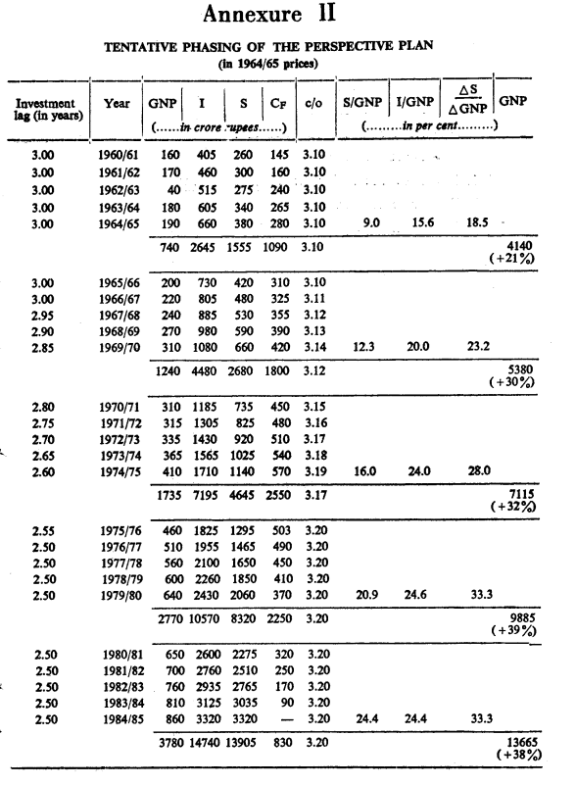
Perspective plan 1965 - 1985
Key Areas
Universal Employment
Universal Education 8th Grade
Source: Said Hasan (19xx) – Some Problems of Perspective Planning in Pakistan

Slide 7
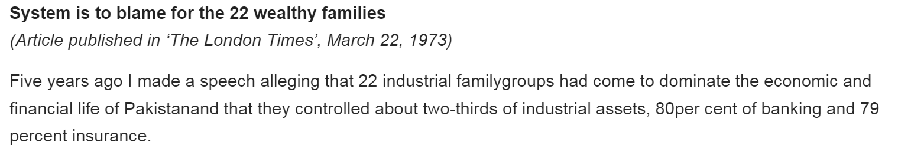
Centralized planning – analysis
Subsidies and tariff protection to exports
  Export Bonus Vouchers
Elite Farming Strategy
  Land Reforms, Consolidation of Land Holdings
Concentrating income in upper income groups
  Target savings rate set at 25% of GDP

Slide 8
Centralized planning – conclusion
Income inequality
Inefficient industrial base
Loan Dependence
Mass movements against President
East Pakistan --- Bangladesh

Slide 9
decentralized development planning
18th Amendment in the Constitution (2010)
7th NFC Award (effective since 2010)
Local Government Devolution Plan 2000

Slide 10
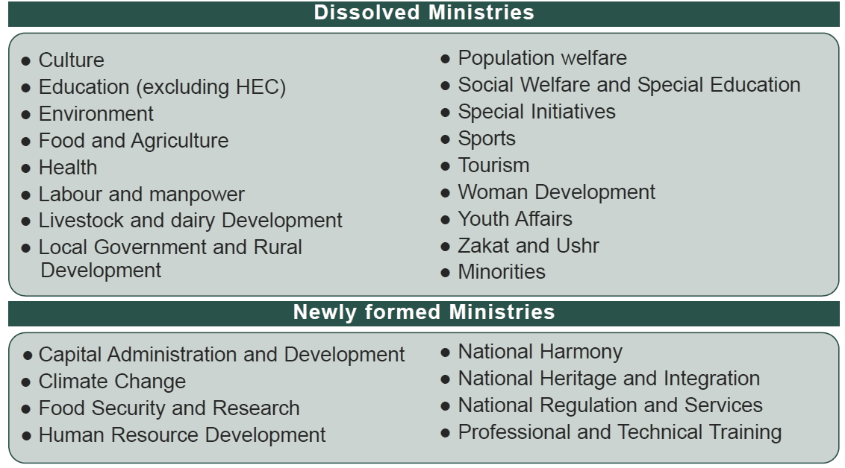
1. 18th Amendment in the Constitution (2010)

Slide 11
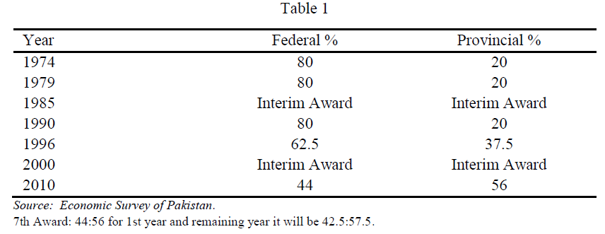
2. 7th NFC Award (effective since 2010)

Slide 12
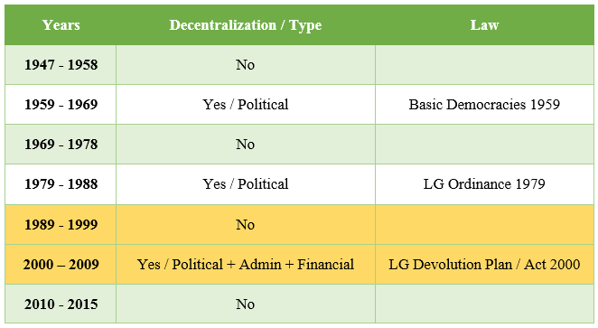
Decentralization in pakistan

Slide 13

operationalization
HUMAN DEVELOPMENT
HUMAN DEVELOPMENT INDEX
EDUCATION INDEX
DECENTRALIZATION
DEVOLUTION IN PAKISTAN
(2001-2009)
DECENTRALIZATION OF EDUCATION

Slide 14
measuring variables
DECENTRALIZATION
PDI – Political Decentralization Index
ADI – Administrative Decentralization Index
FDI – Fiscal Decentralization Index
(Ivanyna & Shah, 2012)
Decentralization Index
DI = (PDI + ADI + FDI) 1/3
HUMAN DEVELOPMENT
Human Development Index
HDI = ( I _{Health} . I _{Education} . I _{Income} ) ^{1/3}
(UNDP)
I _{Education} - index for knowledge measured through mean years of schooling and expected years of schooling

Slide 15
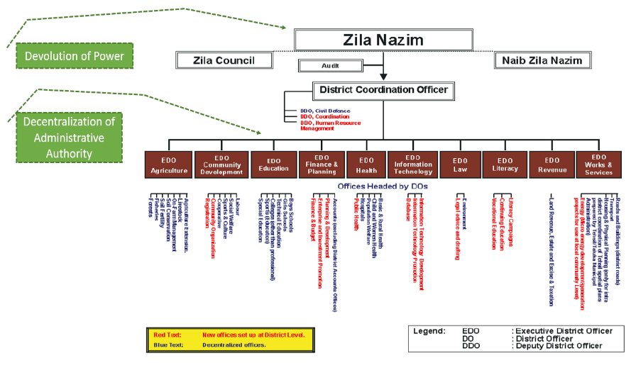
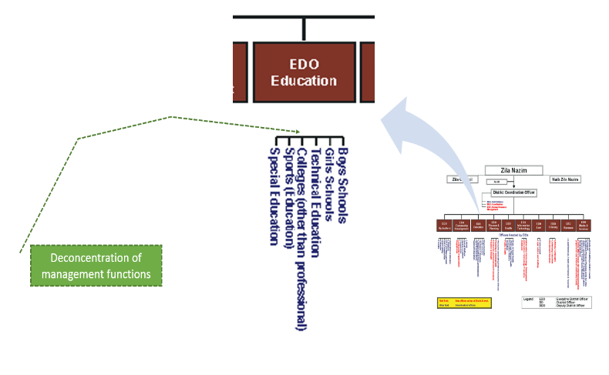
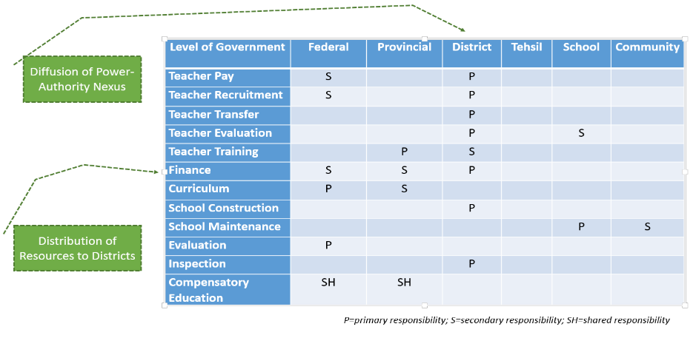
Decentralization of education
Political
Devolution of Power
Diffusion of Power-Authority Nexus
Administrative
Decentralization of Administrative Authority
Deconcentrating Management Functions
Fiscal
Distribution of Resources to District Level

Slide 16
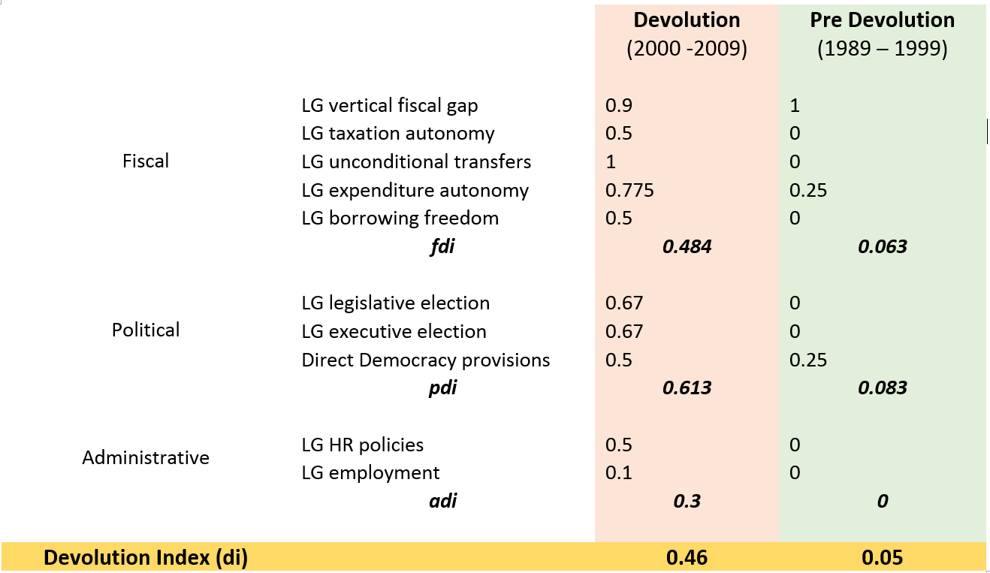
Measuring decentralization

Slide 17
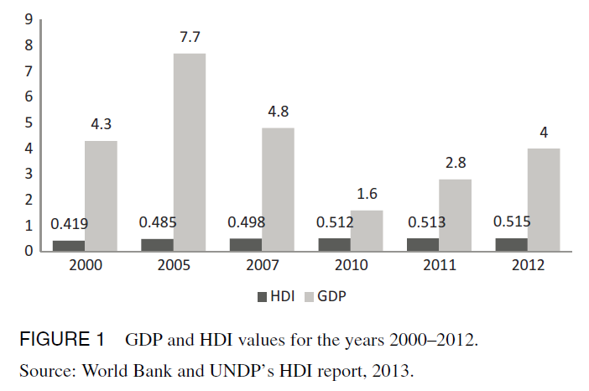
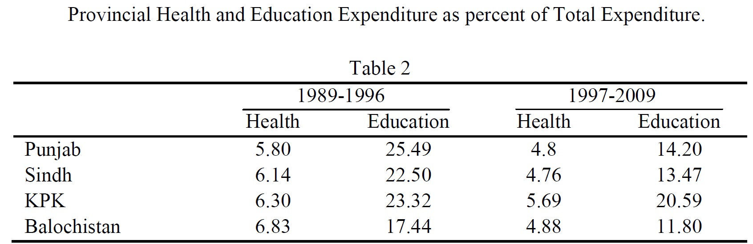
DECENTRALIZATION INDEX AND EDUCATION INDEX
Research Question:
Does decentralization of education contribute in attaining higher education index?
.
Projection:
Longitudinal (time horizon)
Sources:
UNDP – HDR (various), Author’s calculation and projection
Source: Mehmood & Sadiq (2010)

Slide 18
DECENTRALIZATION INDEX AND EDUCATION INDEX
Research Question:
Does decentralization of education contribute in attaining higher education index?
Null Hypothesis:
Decentralization does not contribute in achieving human development.
Sources:
UNDP – HDR (various), Author’s calculation and projection

Slide 19
DECENTRALIZATION INDEX & HUMAN DEVELOPMENT INDEX
Hypothesis:
Decentralization contribute in achieving human development.
Sample:
34 Districts in Punjab Province
Sources:
UNDP – HDR (2015), Ivanyna & Shah (2012), Jamal & Khan (2007), Author’s calculation and projection

Slide 20
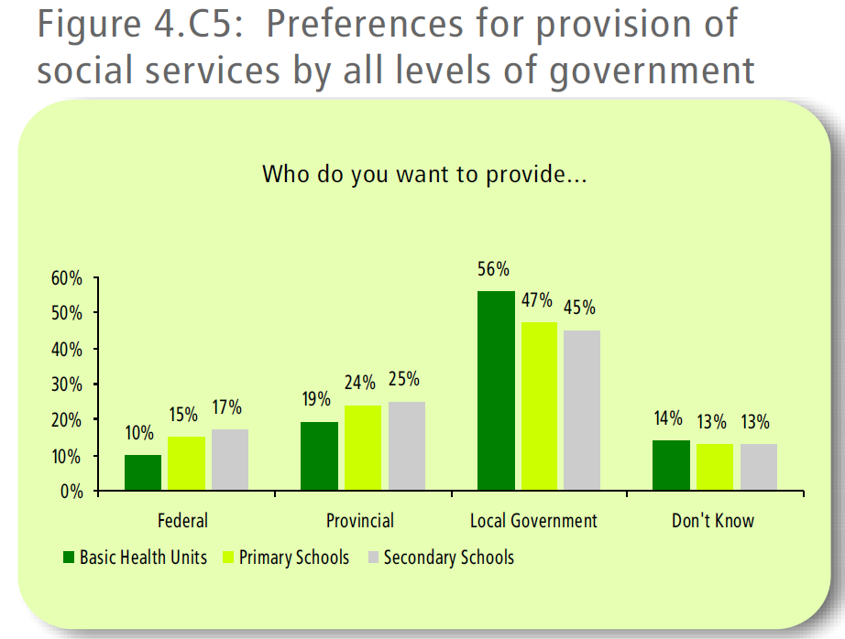
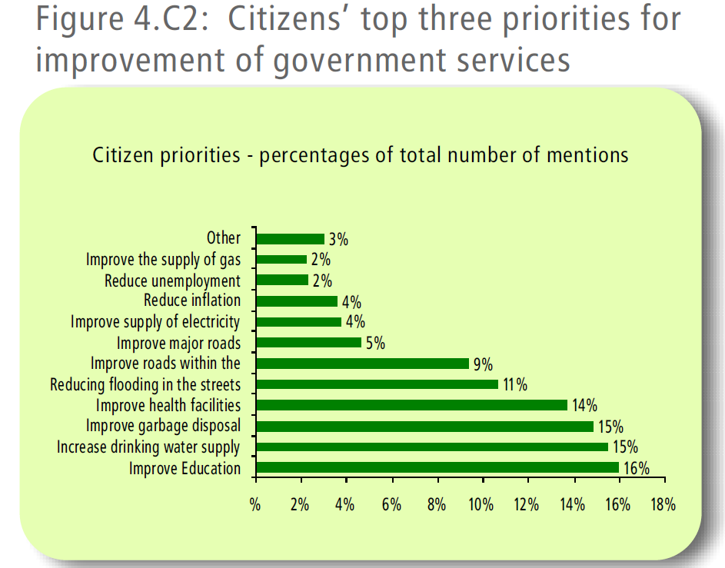
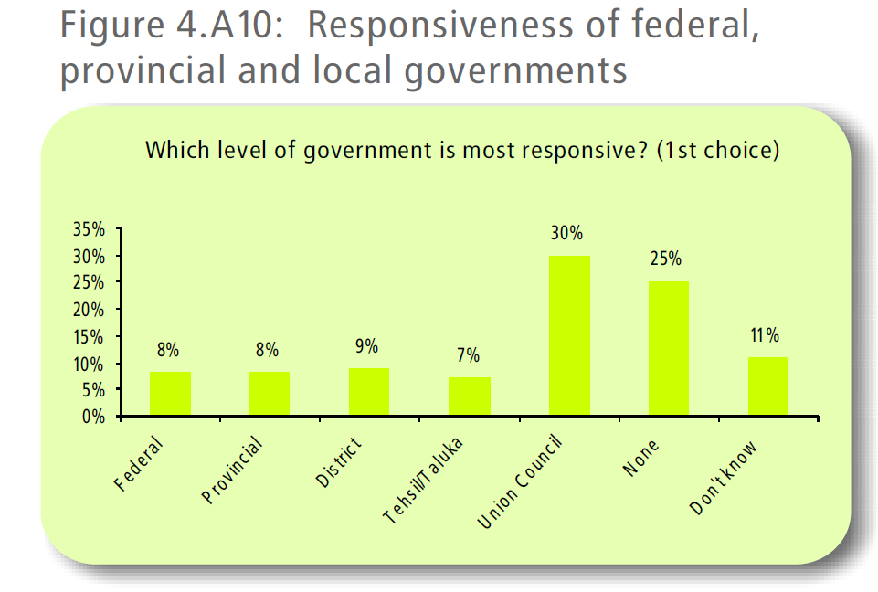
DECENTRALIZATION INDEX & EDUCATION INDEX
Source: USAID (2008) – National Survey “The Local Government System: Citizens Perceptions and Preferences”

Slide 21
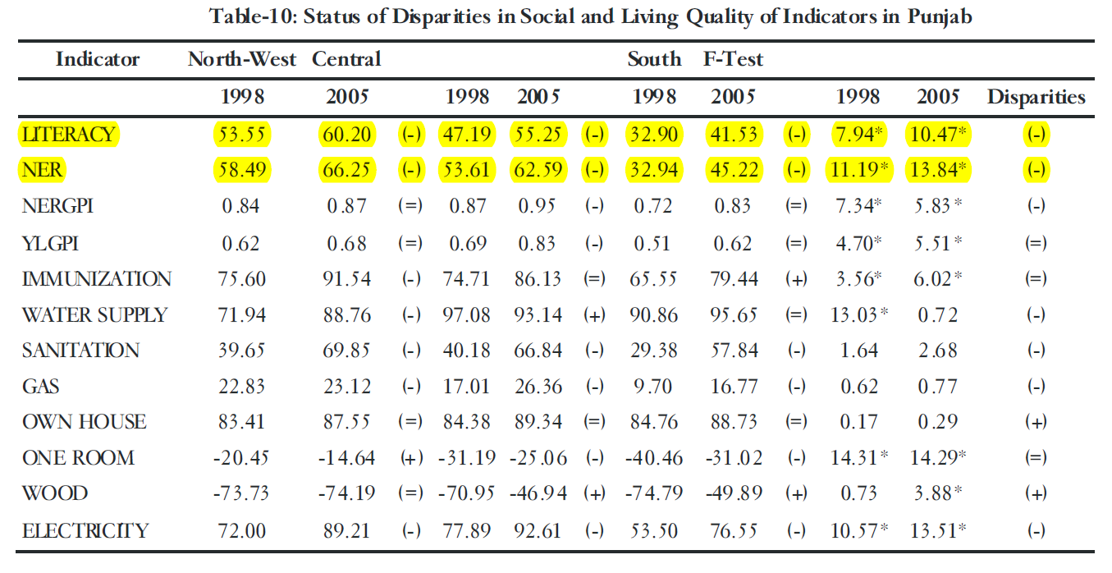
DECENTRALIZATION AND HUMAN DEVELOPMENT
Source: Akhtar (2008): Trends in Regional Inequalities in Pakistan: Evidence Since 1998

Slide 22
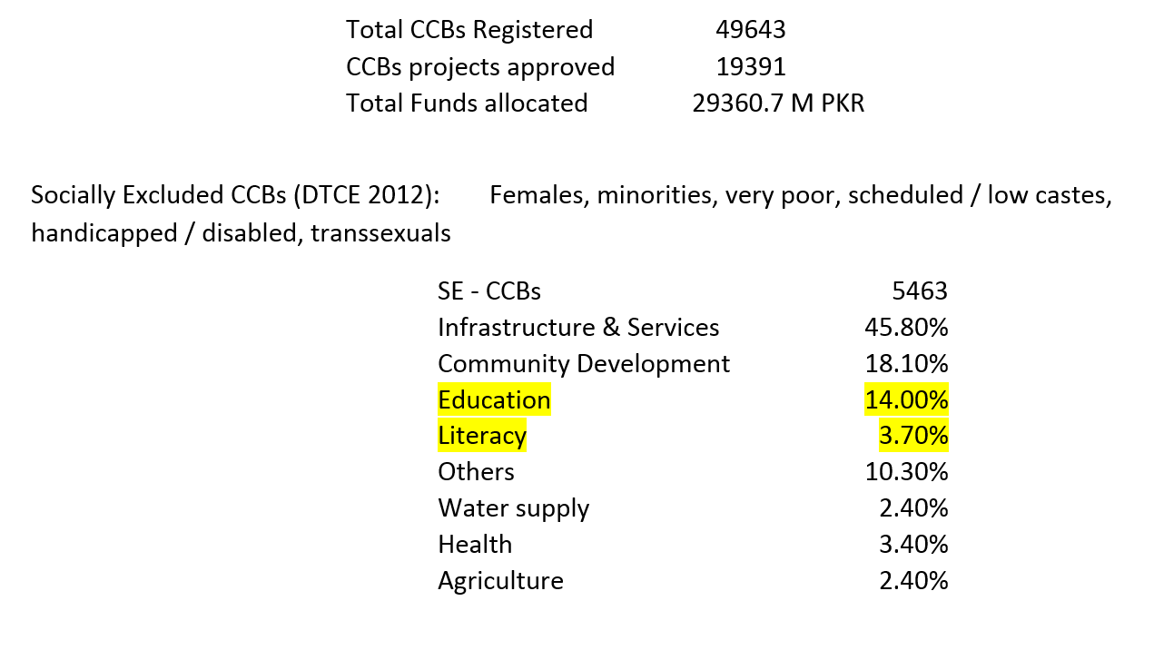
Direct democracy & citizen community boards (CCBs)

Slide 23
POLICY challenges
Lack of Ownership
Elite Capture
Bureaucratic Dissent
Poor Finances
Implementation Issues
Corruption

Slide 24

conclusion
Comparison of Local Government Systems
 | Elected LGS |  |  | Administrative LGS
 | High | Moderate | Low | High | Moderate | Low
Accessibility | ✓ |  |  |  |  | ✓
Responsiveness | ✓ |  |  |  |  | ✓
Service Delivery |  | ✓ |  |  |  | ✓
Addressing Needs | ✓ |  |  |  |  | ✓
Capacity |  |  | ✓ | ✓
Check & Balance |  |  | ✓ |  | ✓
Corruption | ✓ |  |  |  | ✓
Consultation |  | ✓ |  |  |  | ✓
Sense of Ownership | ✓ |  |  |  |  | ✓
Source: UNDP (2012) - Social Audit of Local Governance and Delivery of Public Services 2011 – 2012
Methodology: Qualitative through 30 FGDs conducted in 8 selected districts

